Slide 1
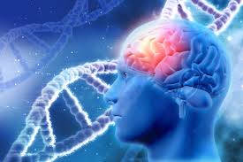
Deep learning model in analysing the Genetic variation associated with the occurrence and progression of Neurodevelopmental disorders
Project Proposal

Slide 2

OBJECTIVE
Design and optimize the pathway for diagnosis, therapeutic intervention, and prognosis by using large multidimensional biological datasets that capture individual variability in genes, function and environment to identify neuro developmental disorders.
Duchenne muscular dystrophy
Cerebral palsy
Autism
ADHD

Slide 3
SCOPE:
To identify and predict the genomic variations among children in the following neurodevelopmental disorders using deep learning model
Duchenne muscular dystrophy
Cerebral palsy
Autism
ADHD
the effective development of deep learning model helps to the early detection of embryonic neurodevelopmental disorders (ENDs) based on its prognostic values could render quality diagnosis and health management
Some of the candidate genes of idiopathic autism (90-95% of all cases) related to brain metabolism are AVPR1a, DISC1, DYX1C1, ITGB3, SLC6A4, RELN, RPL10 and SHANK3.

Slide 4
Team Members
COMPUTER SCIENCE | LIFE SCIENCE
Dr. S. Pitchumani Angayarkanni Associate Professor, Department of Computer Science Lady Doak College | Dr. S. Kalaivani Priyadarshini, Assistant Professor, Department of Biotechnology, Lady Doak College
Dr. Sofia, Associate Professor, Department of Computer Science, Lady Doak College. | Ms. Raga Priya UG Student Bioinformatics TN Agricultural university. Coimbatore

Slide 5
WORK ALLOTMENT

Slide 6
Module | Person Incharge
Data Collection – EHR and genome sequence | Dr. Kalaivani Priyadarshini Ms. Raga Priya
Review of related literature Framing the Architecture for Analysis | Dr. Kalaivani Priyadarshini Ms. Raga Priya
Predictive Analytics of EHR | Dr. G. Sofia Dr. S. Pitchumani Angayarkanni
Deep learning model implementation to analyse genotype and phenotype association study Dissect Genetically Imputed Transcriptomic Profiles Clustering and Classification of various neurodevelopmental disorder in children's based on physical, cognitive , emotional and behavioral | Dr. S. Pitchumani Angayarkanni Dr. G. Sofia
Validating the Analysis at each stage of implementation | Dr. Kalaivani Priyadrashini Ms. Raga Priya
Test dataset analysis | Dr. Kalaivani Priyadrashini Ms. Raga Priya Dr. G. Sofia
Clinical Validation of the Output | Neurologist

Slide 7
Project Mile Stones
Phase 1
Phase 2
Phase 3
Review of Literature
Database Collection
Designing a Novel Machine Learning Architecture
Validation of the Architecture
Feature Analysis
Clustering
Classification Congenital/Acquired/Idiopathic
Test Dataset
Clinical Approach
Research Report depicting Outcome of the results

Slide 8
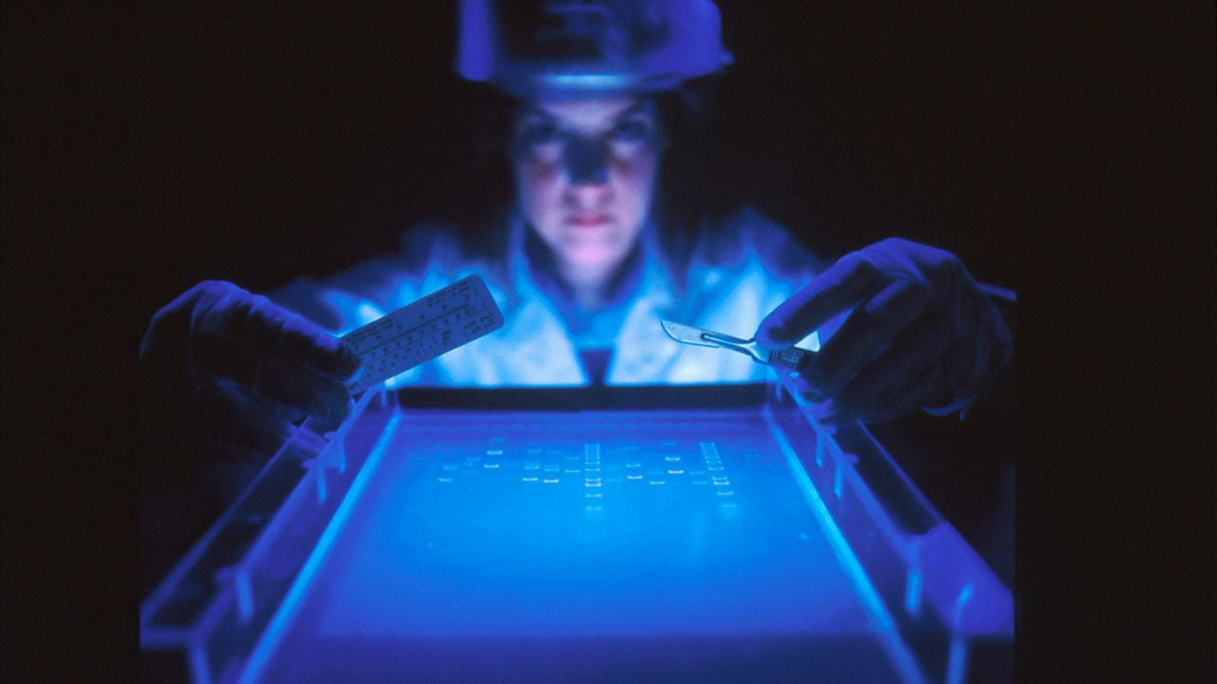
THANK YOU

